Slide 1
Multilayer perceptron
Umarani Jayaraman

Slide 2
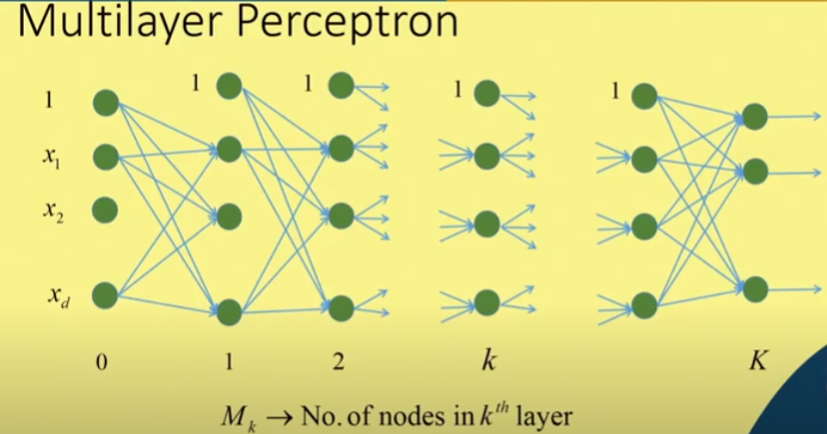

Multilayer Perceptron

Slide 3
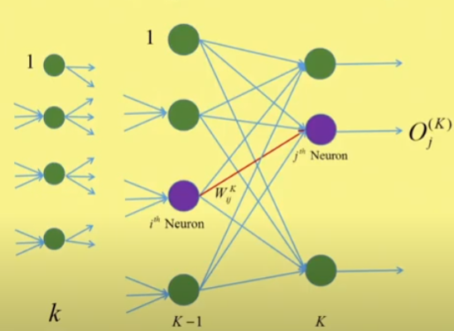
Back Propagation Learning: Output layer

Slide 4
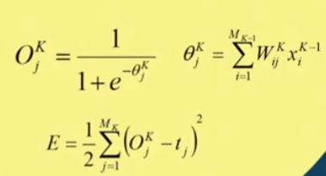
Back Propagation Learning: Output layer

Slide 5
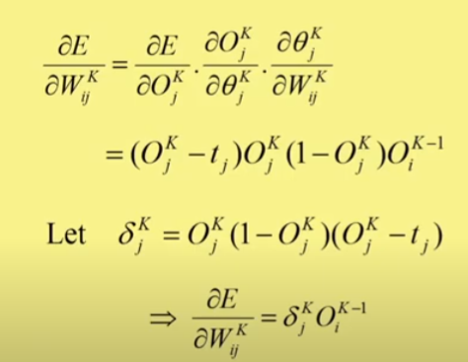
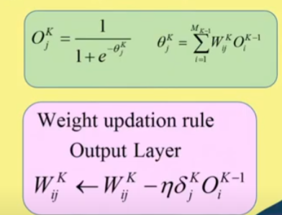
Back Propagation Learning: Output layer

Slide 6
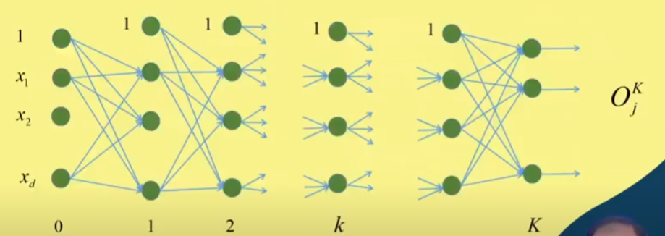

Update the weights at the hidden layer

Slide 7
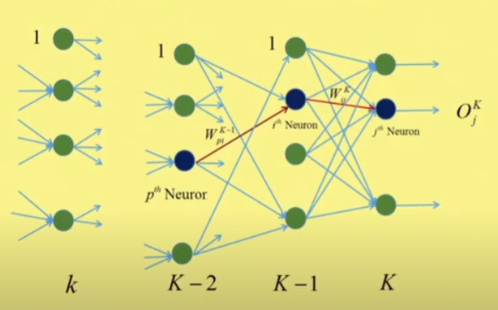
Back Propagation Layer- Hidden Layer

Slide 8
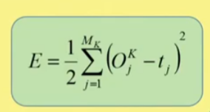
Back Propagation Layer- Hidden Layer

Slide 9
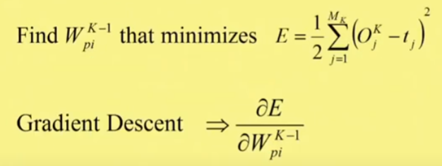
Back Propagation Learning- Hidden Layer

Slide 10
Thank you

